Slide 1
CHATBOT
SUBMITTED BY-
SNEHA DIPTI BCA/40011/19
NEHA KUMARI BCA/40027/19
ZARA AFREEN BCA/40046/19
SNEHA KUMARI BCA/40048/19
GUIDED BY-
DR. UMESH PRASAD

Slide 2
INTRODUCTION
A chatbot is a computer program that simulates human conversation through voice commands or text chats or both. There are a number of synonyms for chatbot, including "talkbot," "bot," "IM bot," "interactive agent" or "artificial conversation entity."
A chatbot system uses conversational artificial intelligence (AI) technology to simulate a discussion (or a chat) with a user in natural language via messaging applications, websites, mobile apps or the telephone. It uses rule-based language applications to perform live chat functions in response to real-time user interactions.

Slide 3
OBJECTIVE
Why Are They Important?
A chatbot is often described as one of the most advanced and promising expressions of interaction between humans and machines. These digital assistants streamline interactions between people and services, enhancing customer experience. At the same time, they offer companies new opportunities to streamline the customer’s engagement process for efficiency that can reduce traditional support costs.
A chatbot can enhance and engage customer interactions with less human intervention. It removes the barriers to customer support that can occur when demand outpaces resources. Instead of waiting on hold, customers can get answers to their questions in real time. Less service friction can improve the brand experience for customers.

Slide 4
Features / Tasks it can perform:
1. Game ( Rock Paper Scissor with GUI)
2. Search anything from google search engine.
3. Volume Control
4. Weather
5. Jokes
6. News
7. Math Calculations
8. Timer
9. In-built search image display
10. Smart Dictionary Search
11. OS Info, Battery Info
12. Opening Websites
13. File Operations (Creating Files)
14. Translator
15. To Do List
16. Directions on Map
17. Screenshots

Slide 5
MODULES REQUIREd:
Chatterbot
Numpy
Pandas
SpeechRecognition
Wikipedia
Pyaudio
Pyttsx3
Webbrowser
Googletrans
Playsound
Tkinter
Pygame

Slide 6
WORKING:
How a Chatbot Works~
Chatbots are trained to act upon the inputs provided by user or they can be driven by rules. They rely on a machine’s ability to interpret human language (spoken or typed) and are trained to respond to interactions. The more data fed to the chatbot, the more human-like the response.
There are two different tasks they perform:
User Request Analysis
Returning the Response

Slide 7
USER REQUEST ANALYSIS
User request analysis is the first and most relevant task a chatbot performs. It is the analysis of a user’s request which is used to identify intent and extract relevant entities. A chatbot’s capacity to understand the language and context of a request is critical to its ability to provide an accurate response.

Slide 8
RETURNING THE RESPONSE​
Once user intent has been identified, the chatbot must provide the most appropriate response to the request. The answer may be in the form of:
a generic and predefined text;
a text retrieved from a knowledge base that contains different answers;
a contextualized piece of information based on data the user has provided;
data stored in enterprise systems;
the result of an action that the chatbot performed by interacting with one or more backend applications; or,
a disambiguating question that helps the chatbot correctly understand the user’s request.

Slide 9
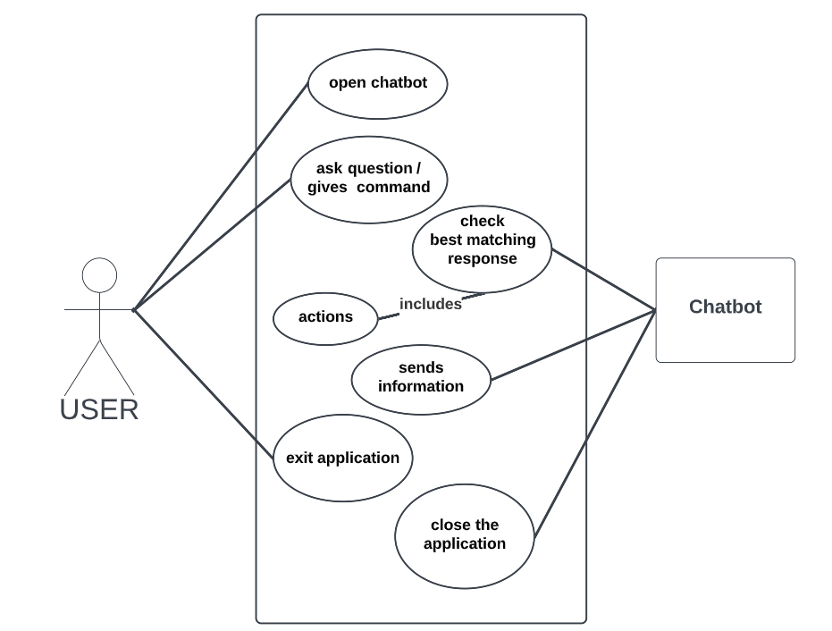
UML USE CASE DIAGRAM

Slide 10
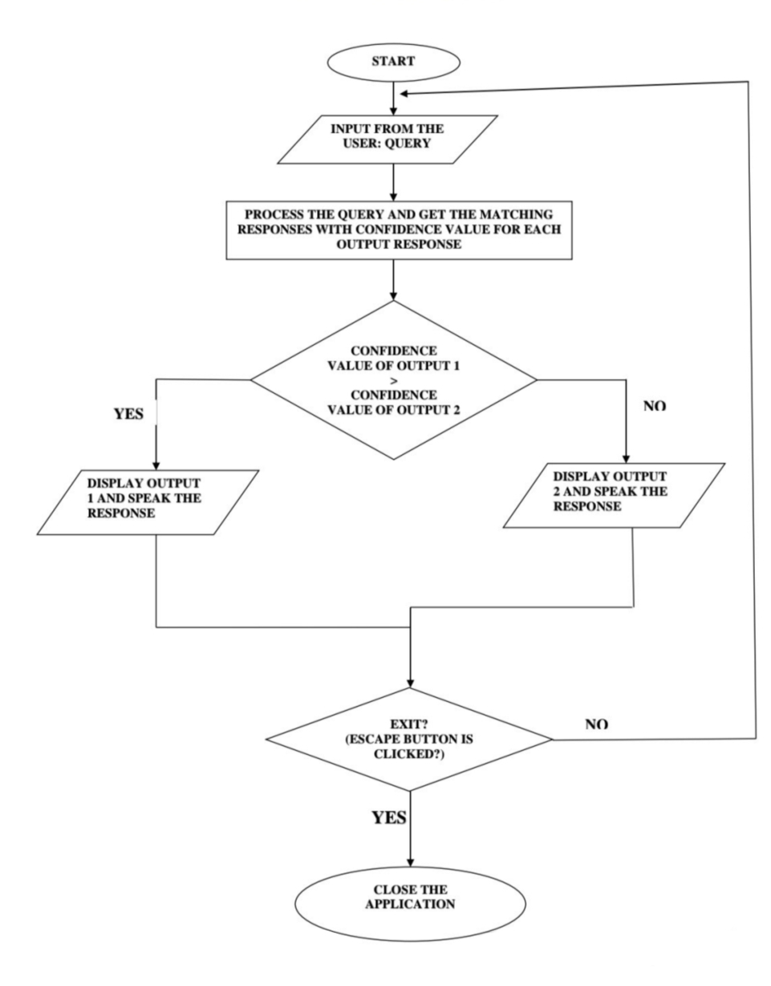
FLOW CHART

Slide 11
WHO IS USING CHATBOTS?
While chatbots have become fixtures in the online retail space to streamline customer support, they have also been widely adopted in industries such as finance, healthcare, and insurance. Beyond customer support, you see sales teams use chatbots to steer customers through the sales funnel and marketing teams to generate qualified leads.
Chatbots are a type of digital assistant designed to improve business efficiency by automating routine support tasks. They can save businesses as much as 30% on their customer support costs. They can also generate revenue by converting abandoned cart transactions into sales. They streamline customer support through automation and, according to Juniper Networks, can save consumers and businesses over 2.5 billion customer service hours by 2023.

Slide 12
HERE ARE FEW EXAMPLES OF HOW CHATBOTS ARE BEING USED IN THE REAL WORLD:
Verizon uses them to answer initial customer support issues.
The Transportation Security Administration (TSA) uses them to automate AskTSA on Twitter and Facebook.
Can Schedule meetings, broadcast, newsletters, auto-sequences acquire leads for comments.
Multilingual chatbots saves from investing much on hiring different languages resources.

Slide 13
LIMITATIONS
In its initial stages, it isn't the most efficient in making conversation. However, it does get more and more efficient with each conversation i.e. it gradually increases its scope of intelligent responses.
Being a bot essentially limits the scope of expression and personality traits in a conversation.
Chatbot intelligence is fully automated and so not all responses may efficiently satisfy complex user queries.
They can't make decision. They don’t have the knowledge how to differentiate between the good and the bad.
Chatbot have the same answer for multiple queries.

Slide 14
Future scope
Looking ahead to the future scope of chatbots, bots need to further develop their NLP and ability to go off-script.
In companies with many options, products or services, users will naturally be slow, forgetful and interruptive. Chatbots will need to reflect the nuances(subtle difference) of conversation, human memory and development in order to become a valid replacement for customer service agents who even despite language barriers can exhibit patience, intelligence, understanding and flexibility.
Chatbots are AI devices and, looking ahead, they need to keep up with AI trends, such as automated machine learning, easy system integration and developing intelligence.

Slide 15
CONCLUSION
From my perspective, chatbots or smart assistants with artificial intelligence are dramatically changing businesses. There is a wide range of chatbot building platforms that are available for various enterprises, such as e-commerce, retail, banking, leisure, travel, healthcare, and so on.
Chatbots can reach out to a large audience on messaging apps and be more effective than humans. They may develop into a capable information-gathering tool in the near future.
There is one solution primed to satisfy the modern customer, and that is a chatbot. With a chatbot, your organization can easily offer high-quality support and conflict resolution any time of day, and for a large quantity of customers simultaneously.

Slide 16
THANK YOU

